Slide 1
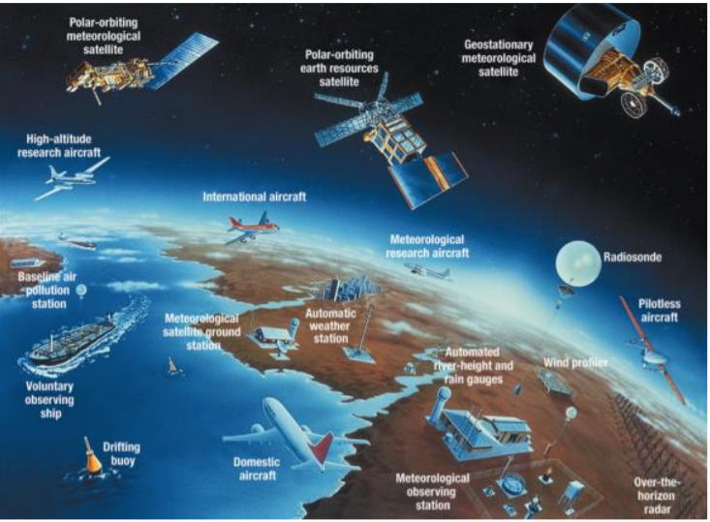
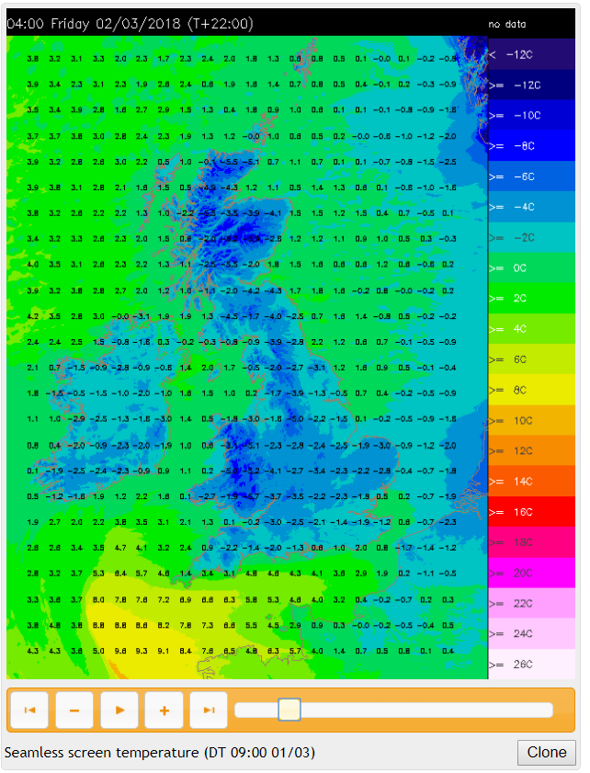
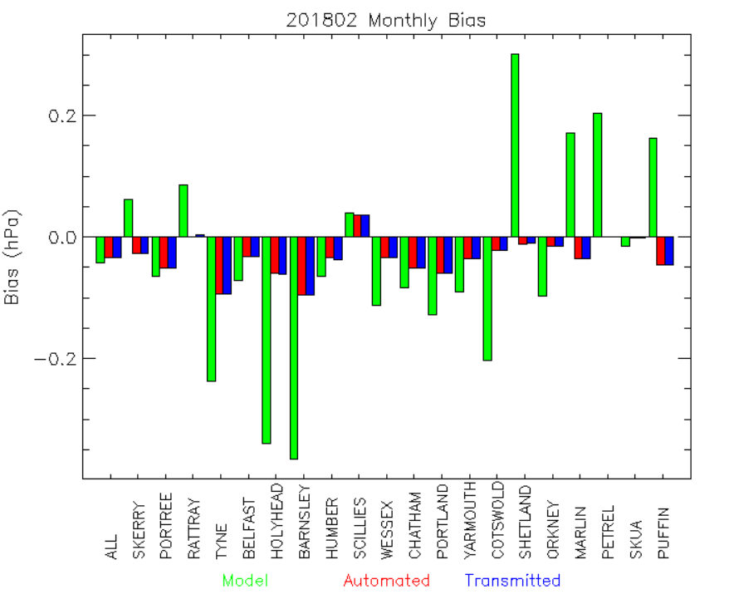
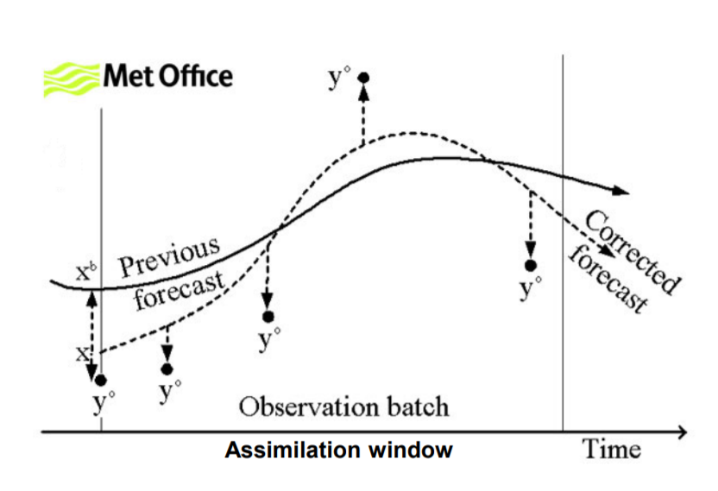
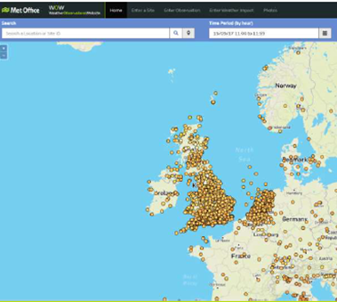
Challenge: High resolution models need high resolution observations
Observations
Verification
Model Forecast
Data Assimilation
Notes:
Issued forecasts are only as good as the model, and the model is only as good as the observed data it is based on. This places observation data at the heart of what we do at the Met Office. Observations of the atmosphere are assimilated into the Met Office numerical models, the observations are used to adjust the model background to produce an analysis. This is then projected forward by the model to produce a forecast. Observations are used again to verify the models.
Our challenge is as we increase the resolutions of our models we need higher resolution observations, both spatially and temporally, to use in assimilation and verification. It is not practical or affordable to increase the resolution of our traditional networks, such as surface weather stations and weather balloons, so we have started looking to non-traditional sources of observations. For example we use the atmospheric delay between GPS satellites and receivers to gain information about the amount of water vapour in the atmosphere, this is currently being assimilated into our models. We are investigating using information transmitted between aircraft and air traffic radars to calculate wind speeds and directions, and are currently working on using this additional source of observations in our models. A bigger challenge still is how to use crowd sourced observations in our models, such as those from our weather observations website, WOW, which involves automatic weather stations in people’s back gardens, and more recently temperature data from vehicles. There is a lot of information potentially available through crowdsourcing but are not yet using it to support our NWP models as we need to do more work on how to quality control such data,
Characteristics that affect the impact of observations on forecasting: • Data quality • Variables measured (and how they are used in NWP) • Direct/indirect measurements • Number of observations • Location of sites • Data density • Data frequency • How ‘unique’ information is (in space or time) – is similar information available from other sources? Are the observations in data sparse areas? • Effectiveness of assimilation – e.g. how well errors and biases are represented

Slide 2
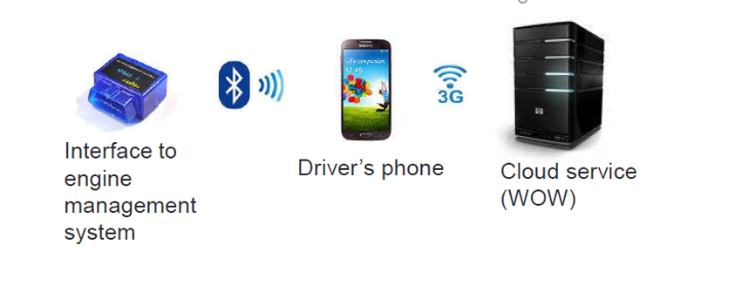
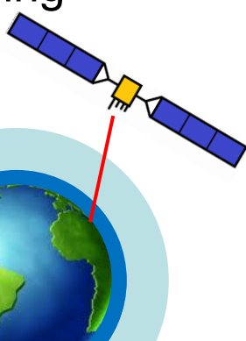
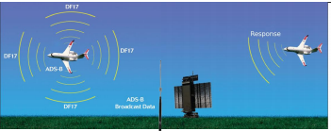
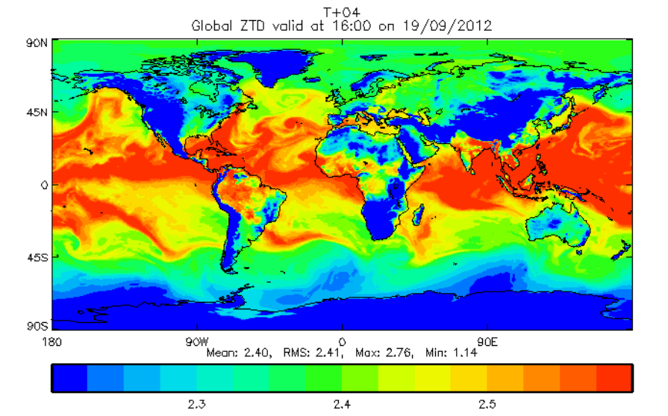
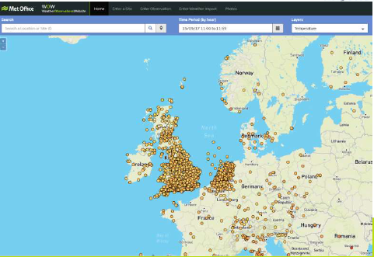
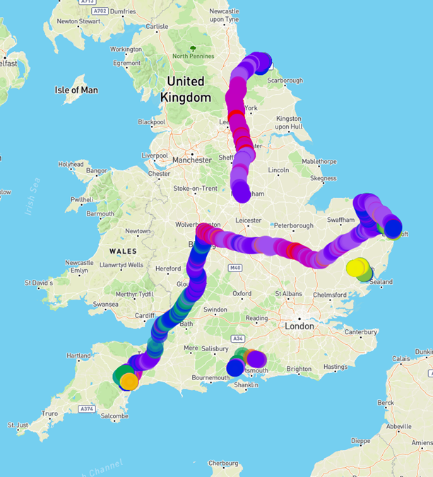
Mode-S EHS
GNSS Water Vapour
Notes:
Issued forecasts are only as good as the model, and the model is only as good as the observed data it is based on. This places observation data at the heart of what we do at the Met Office
GNSS water vapour: signal between GPS sat and ground receiver bent and delayed by atmosphere. Zenith total delay (ZTD) is a measure of atmospheric refractivity, you can calculate and subtract the expected the dry air delay to leave the delay from wet air – related to water vapour. This is used in NWP and improves humidity, cloud cover and surface temperature estimates in the model. The ionospheric delay also useful in space weather forecasting.
Mode-S EHS: automated messages between aircraft and air traffic radars intercepted by a network of receivers (based on raspberry pi technology), information within the messages can be used to calculate wind speeds and temperatures. 6-8 million obs a day. Initial trials have shown an overall positive impact on NWP.
WOW: For voluntary climate observers and weather enthusiasts. Also ingesting observations from novel sources eg cars. Trial running at the moment. Not assimilated. We need to do more research into the quality of such data before it is assimilated, working with academic community eg DARE and DREAM to do this sort of research.

