Slide 1
Innovative ecological modelling for water quality impact
John Murray-Bligh
UKEOF Modelling & Monitoring Workshop
Birmingham
7 March 2018
Notes:
John Murray-Bligh
+44 (0)7714 710 507
john@murray-bligh.fslife.co.uk
John.murray-bligh’environment-agency.gov.uk

Slide 2
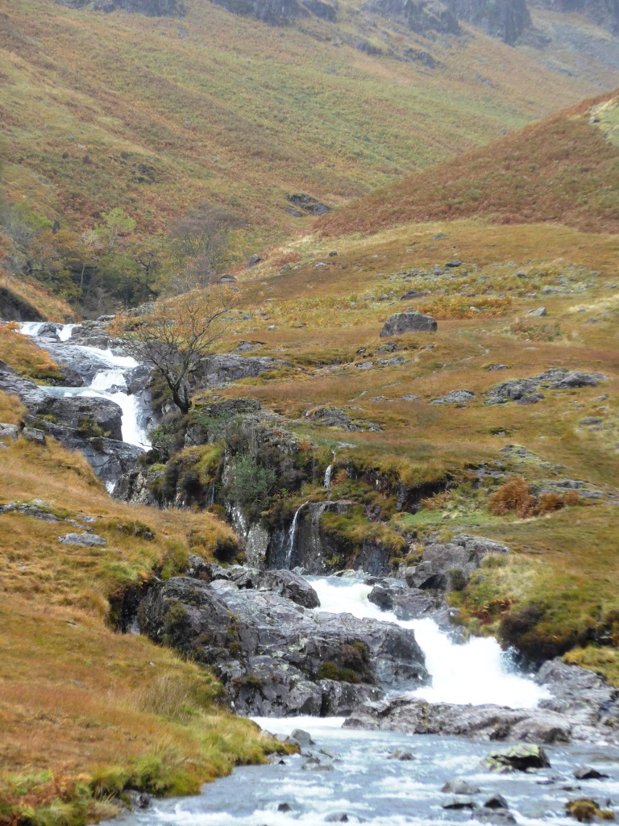
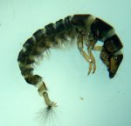
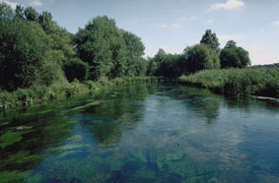
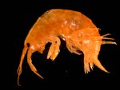
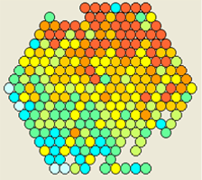
Measure quality and identify causes of poor quality
Sensitivity (WHPT) 7.14
Number of taxa 21.4
Sensitivity (WHPT) 4.17
Number of taxa 41.7
River Pressure Diagnostic System (RPDS)
255 community types from 72000 biological samples, associated with: 42 chemicals (percentiles from 10M samples); shading; morphology & habitat (River Habitat Survey, 71 parameters + 12 RIVPACS environmental parameters) flow (7), Land risk analysis (6); perceived stresses (228); Land use (16)
Machine learning: Mutual information & regression maximisation MiRMax
H
G
River Invertebrate Prediction and Classification System (RIVPACS): 43 natural community types based on 658 samples, predicted from 12 environmental parameters
Multivariate analysis: TWINSPAN, multiple discriminant analysis MDA
M
P
B
Notes:
Problem:
different types of streams support different biotas.
They are likely to have different BMWP-scores (ASPT and N-taxa), even when pristine
How do we compare ecological water quality in different streams, different parts of the same stream (e.g. headwaters and deep lowland sections), different rivers across the country?
RIVPACS enables us to do this, because it predicts what the invertebrate community would be in any type of stream un the UK (at any place in any stream) if it was unstressed.

