Slide 1
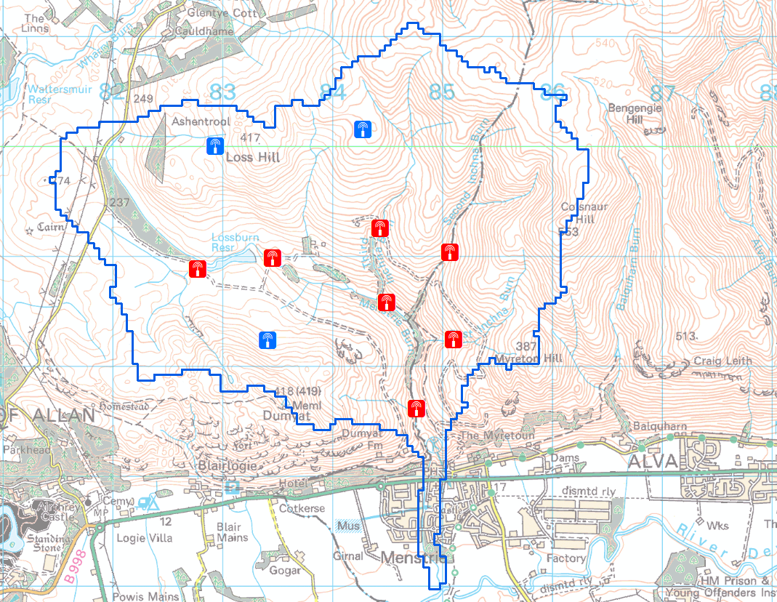
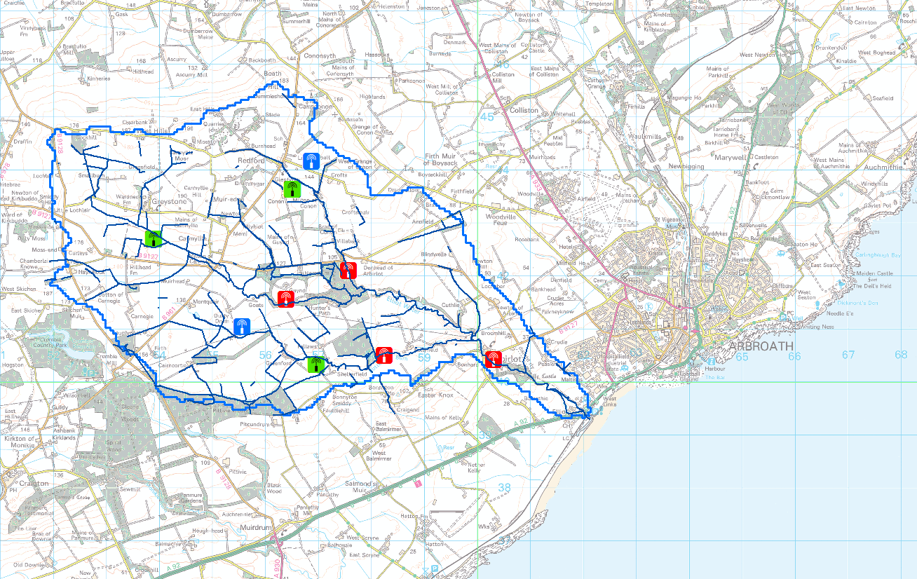
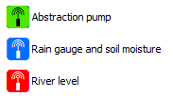
IoT / Autonomous Sensors
3 trials ongoing
Using LoRa Protocols
Flood Alert Study
Water Resources study
River Level study
Cheap, cloud based solutions
Scottish Govt, Scottish Water involved
Contact jonathan.bowes@sepa.org.uk for full details.

