Slide 1
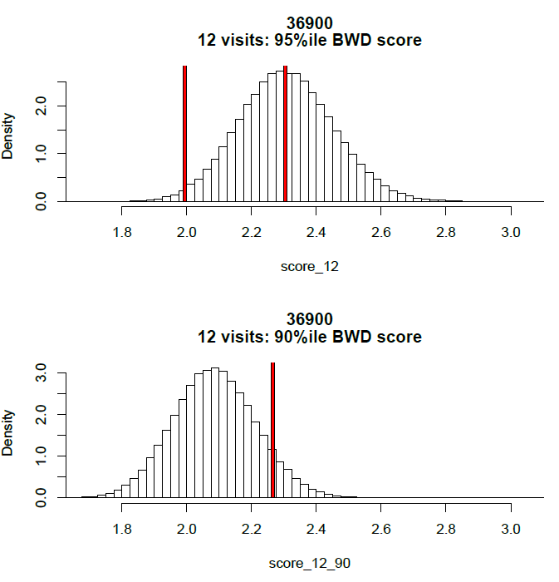
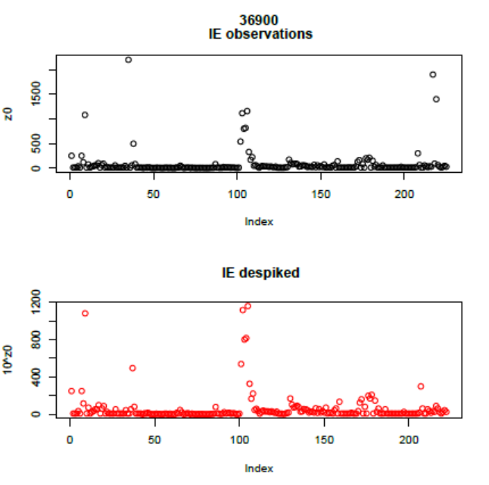
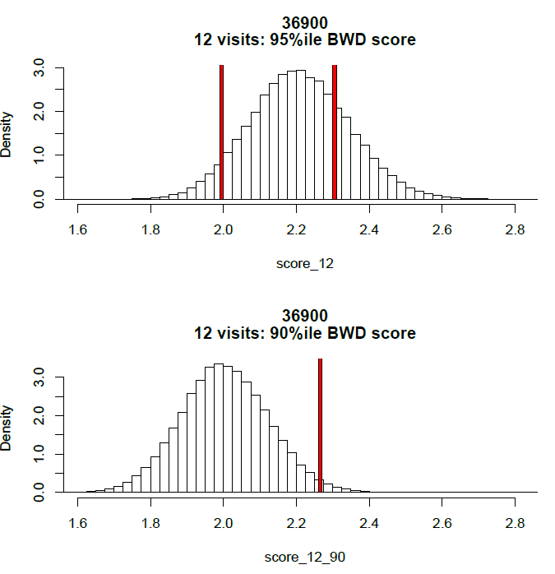
A
20 visits:mean
20 visits:error
B
Bathing Waters Directive statistical analysis:
A. modelling reduced sample visits
B. removing data anomalies (‘spikes’)

