Slide 1
Water Quality Modelling & Monitoring
Graeme Cameron
Informatics Unit
UKEOF Workshop
March 2018

Slide 2
Modelling Overview
SAGIS Modelling Framework
Known Point sources
Diffuse sources from co-efficient database
Uses SIMCAT engine
Generates Source Apportionment Outputs
Used within SEPA for (among others)
Regulation of discharges
RBMP planning & implementation
Catchment investigations

Slide 3
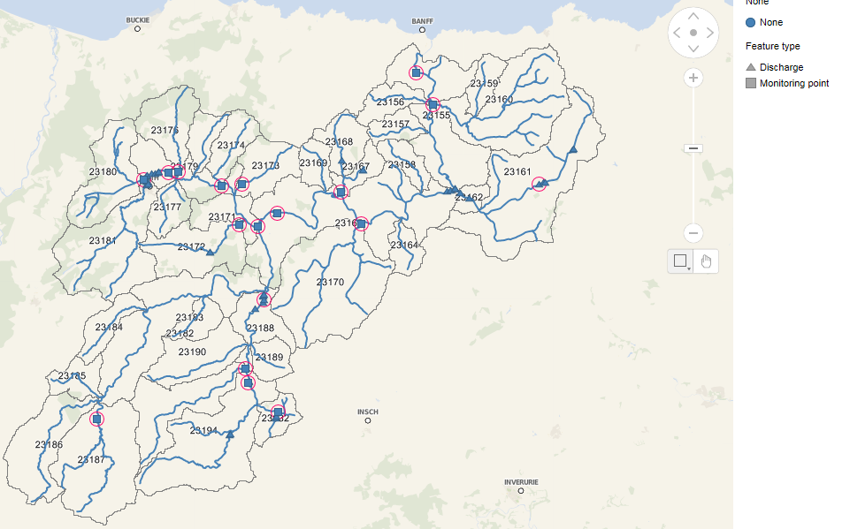
Known Points are Mapped
Discharges
Water Quality Monitoring
Flow Gauging

Slide 4
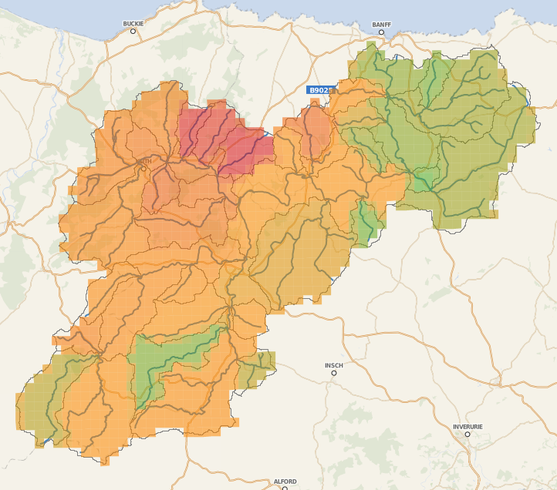
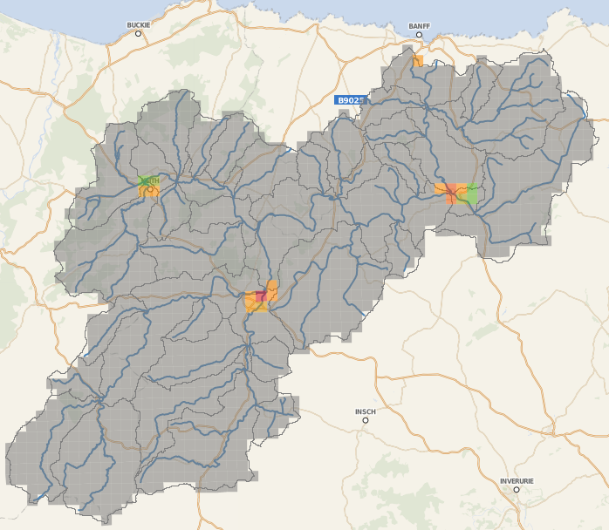
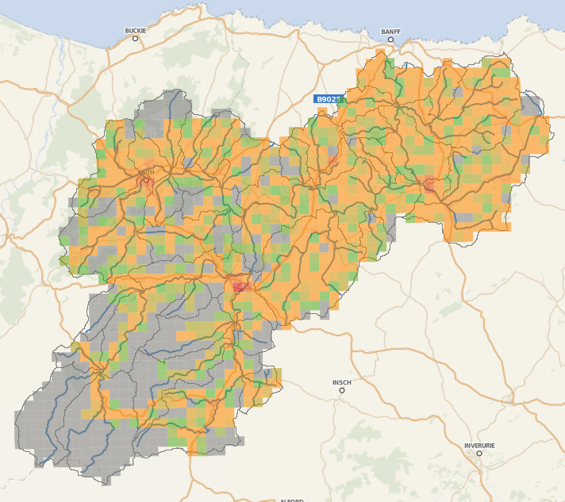
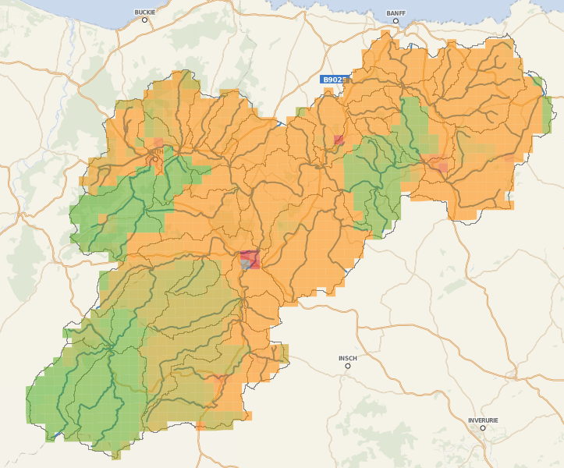
Diffuse Inputs are Calculated
Livestock Farming
Arable Farming
Urban Runoff
Highway Runoff
Septic Tanks
Natural Background
Intermittent Discharges
Atmospheric Deposition

Slide 5
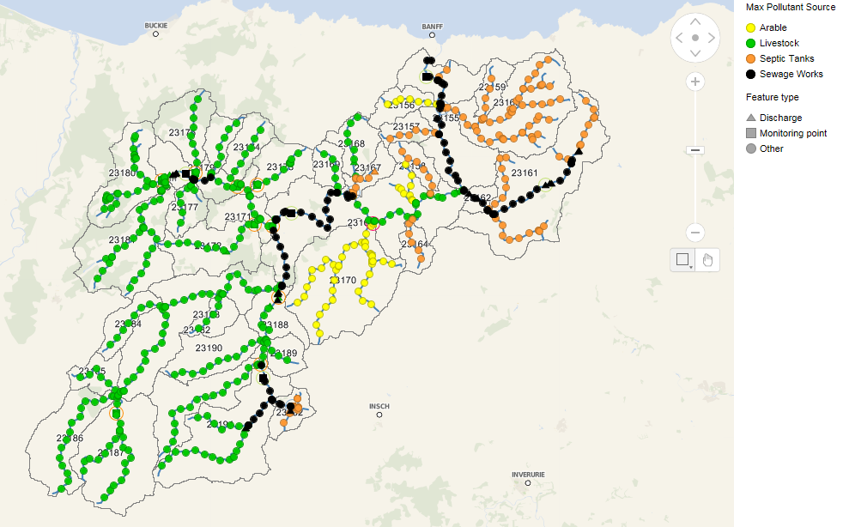
Gaps Extrapolated, Modelled & Calibrated
Monte Carlo Mass Balance using SIMCAT
Additional point frequency can be specified – 1 km

Slide 6
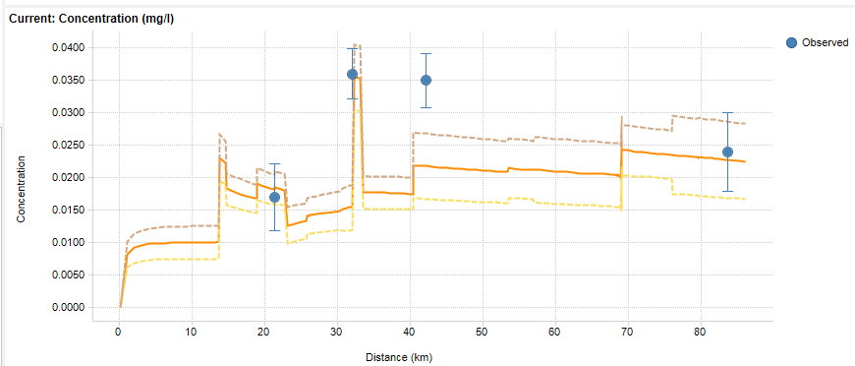
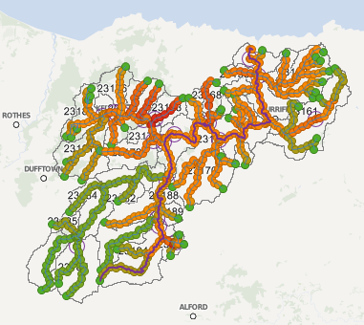
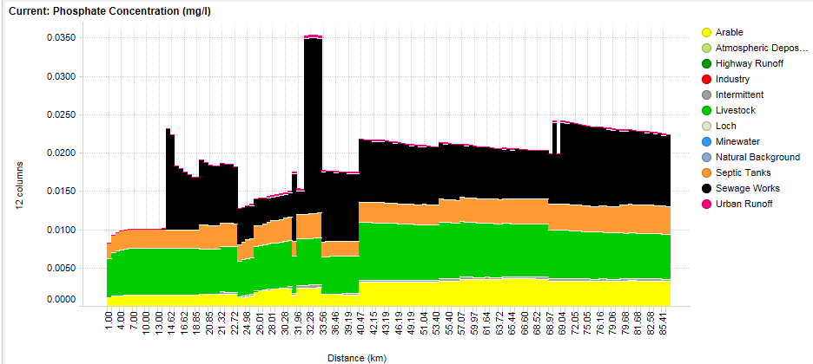

Slide 7
No model is ever perfect. We are always looking for ways to inform the process and improve the modelled outputs.

Slide 8
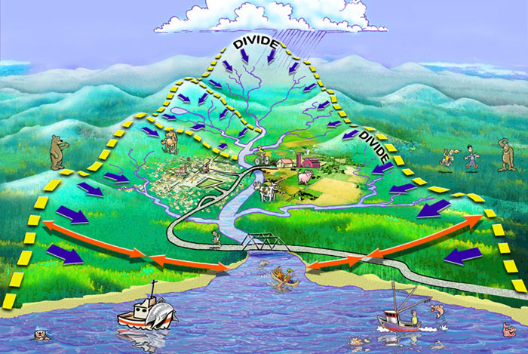
?? Uncertain abstraction volumes
!! Improve regulatory monitoring/reporting; sensors
?? Uncertain flow regime
!! obtain improved flow estimates; undertake gaugings; install devices
?? Uncertain climate
!! run climate change scenarios; update with latest UKCIP information
!! Certain model calibration
!! Reduce monitoring effort; redeploy monitoring effort elsewhere
?? Uncertain point source loads (WWTWs, CSOs etc.)
!! improve regulatory reporting (ODR) and monitoring regimes
?? Uncertain diffuse loads (agriculture, septic tanks, forestry etc.)
!! Farm inspection activity; use higher resolution models to improve estimates; Commission R&D; deploy intensive monitoring in priority catchments
?? Uncertain urban impact
!! Model population growth scenarios; improve diffuse urban runoff estimates
?? Uncertain model calibration
!! Additional routine monitoring to improve data confidence; Blitz monitoring to identify unknown issues
Modelling ←→ Monitoring
Feedback Mechanism
?? Uncertain waterbody classification
!! Additional monitoring to improve data confidence and confirm status

