Slide 1
Kieran Arnold
Head of Satellite & Mobile Communications

Slide 2
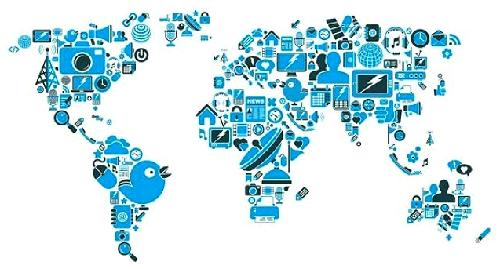
The Internet of Things (IoT)
Internet of Things brings together :
Devices or Sensors
People , Communities ,Society
Single or Multitude of Data types
Process or processing
turning information into actions that create new capabilities, richer experiences, and economic opportunity for businesses, individuals, and countries.

Slide 3
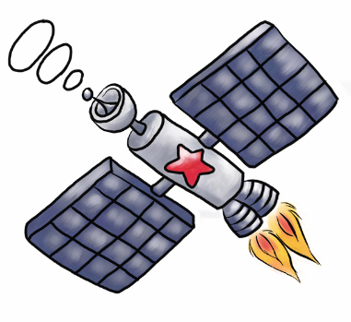
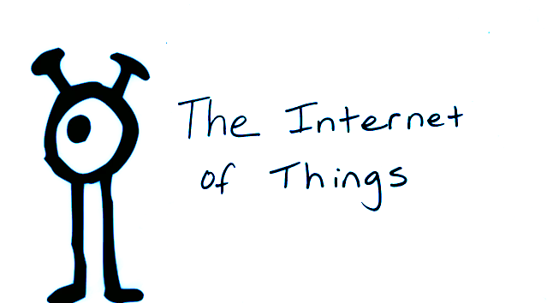
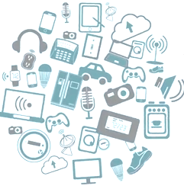
The Internet of Things (IoT)
In 2008 the number of “things” connected to the internet exceeded the number people on the earth.
By 2020 its estimated over 50 billion things will be connected to the internet.
With IPv6 protocol we will have :
340,282,920,938,463,463,374,607,431,768,211,456
Possible internet addresses
or
100 Internet protocol addresses per atoms on earth

Slide 4
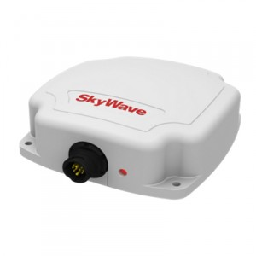
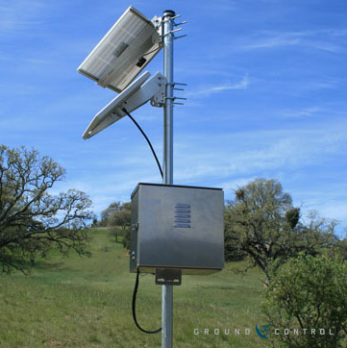
Remote connectivity via Satellite
Connecting remote sensors via satellite backhaul to central data processing centre.
Commercial Machine 2 machine
Satellite terminal

Slide 5
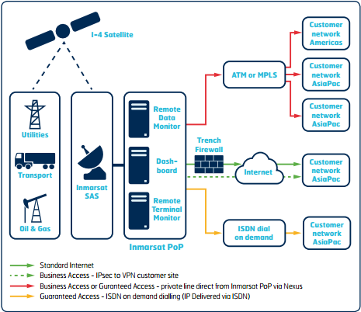
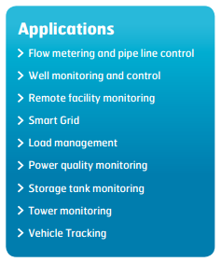
Machine to Machine (M2M)

