Slide 1
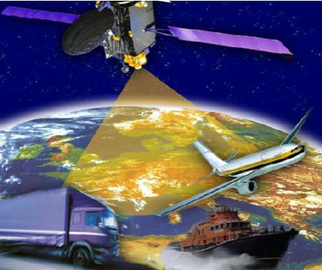
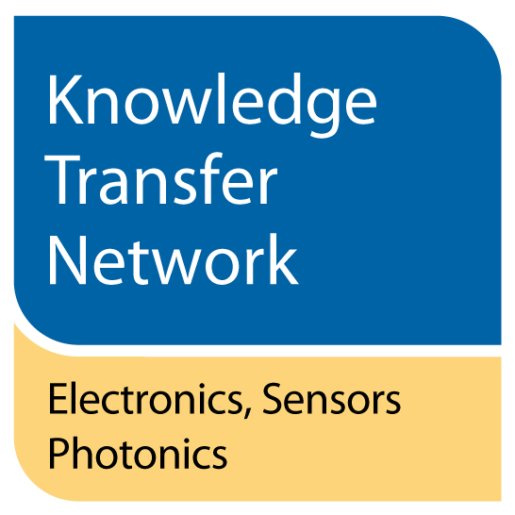
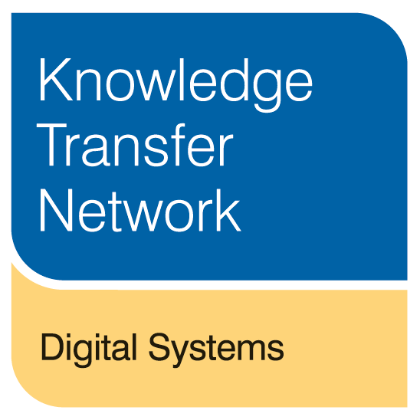
Satellite remote sensing technologies and tools for Navigation Position and Timing
Alex Efimov, KTN
Notes:
Slide tips:
1 don’t be afraid of white space, we want a nice lean and clean look
2 try and use the two purple colours plus dark grey for any large areas that would be black
3 headlines are Arial MT Ultrabold
4 General text is Calibri

Slide 2
KTN Fun Facts
Σ(KTN)_{n=15} =THE KTN as of the 1st of April 2014
Chairman: David Lockwood, Laird Plc
CEO: Chris Warkup
Workforce: 110
Office locations: Edinburgh, Runcorn, Harwell, Cambridge, London, Horsham
Notes:
Slide tips:
1 don’t be afraid of white space, we want a nice lean and clean look
2 try and use the two purple colours plus dark grey for any large areas that would be black
3 headlines are Arial MT Ultrabold
4 General text is Calibri

Slide 3
Satellite Remote Sensing
REMOTE SENSING PRINCIPLE
The EMR reflected, emitted, or back emitted, or back scattered from an object or geographic scattered from an object or geographic area is detected and used to approximate properties of interest
Passive
Sun’s energy which is reflected (visible) or absorbed and re-emitted as thermal infrared wavelengths
Active
Radiation emitted from a satellite is then reflected detected and measured
(LIDAR, RADAR)

Slide 4
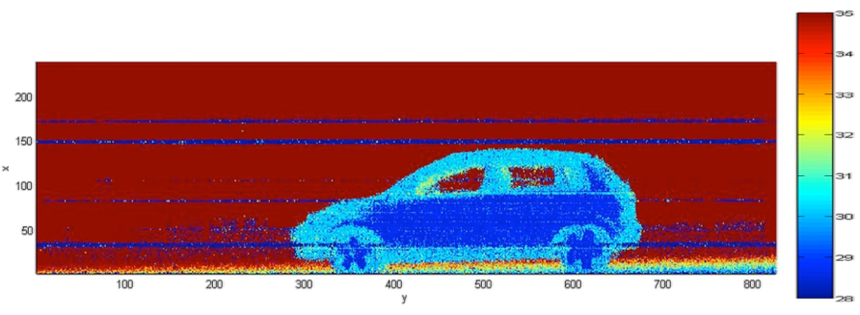
Satellite LIDAR Developments
3D imaging LIDAR (image from ESA)
3D imaging LIDAR could build a complete picture of targets or surfaces
NASA satellite with LIDAR technology produced a first-of-its-kind map of tree-canopy heights around the world.
ESA satellite ADM-Aeolus that is due for launch in 2015

Slide 5
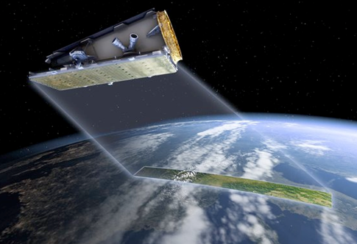
NovaSAR-S Synthetic Aperture Radar
S-Band Radar
Low cost small satellite
Applications include:
maritime surveillance
monitoring the environment, including ice cover, iceberg monitoring, pollution and bathymetry

Slide 6
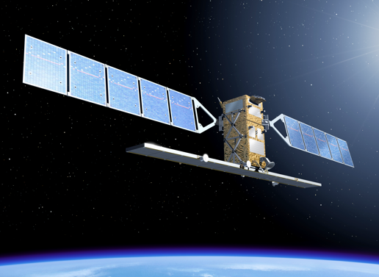
Sentinel-1
Sentinel 1= 2 EO Satellites
C-Band SAR with medium and high resolution sensor
Applications include:
Land and ocean monitoring
Works in any ambient weather and light conditions
Sentinel-1 is almost ready for launch on 3 April 2014

Slide 7
Positioning, Navigation and Timing
Global Navigation Satellite Systems:
GPS (US, military controlled)
GLONASS (Russia, military controlled)
European Geostationary Navigation Overlay Service (EGNOS) (EU, regional, GPS overlay, civilian)
Beidou (China, currently regional, expected to become global by 2020)
Galileo (EU, global, civilian, expected by 2020)

Slide 8
What accuracy do you need?
GPS signal in space will provide a "worst case" pseudorange accuracy of 7.8 meters at a 95% confidence level. Depends on receiver and ambient environment conditions (www.gps.gov)
GLONASS results based on a real life test with various navigation receivers showed the maximum error of 38m and the average error 7.32m.
EGNOS allows users in Europe and beyond to determine their position to within 1.5m

Slide 9
Reliability Issues
Potential causes for disruption:
Obscuration: foliage, buildings, power lines, tunnels, etc.
Electronic interference natural or malicious
Space weather
Mitigation:
EGNOS: ground based segment + GEO satellites
Alternative positioning references: WiFi and similar
Inertial navigation

Slide 10
What? Where? When?
Data from sensor systems provide descriptive environmental information
Sensing data combined with positioning data allows spatial analysis (import into GIS, combining satellite, aerial and ground based sensing data)
Combining the above with timing provides decision makers with actionable information

Slide 11
Opportunities for sensing and PNT innovation
PNT resilience
Indoor PNT
Growing use of mobile devices: opportunities for PNT and sensing
Co-operative PNT
Crowd sourcing
Smart system integration

