Slide 1

Exploring new methods for monitoring peat extent and condition in Wales (...woodland and HNV)
Bridget Emmett¹, Barry Rawlins², Francesca Cigna², Colm Jordan², Lindsay Maskell¹, Chris Evans¹ , Emma Tebbs¹ and the GMEP team
¹Centre for Ecology and Hydrology
² British Geological Survey
(and also representing the Wales Environment Research Hub)

Slide 2
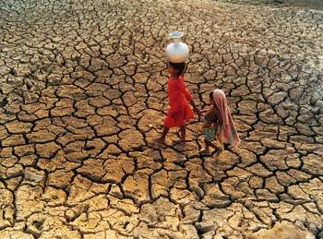
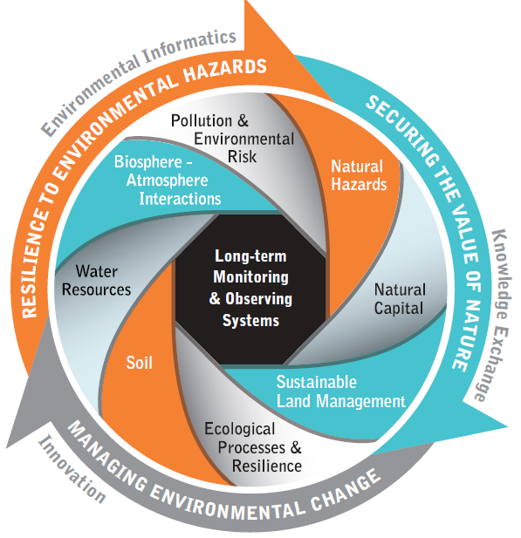
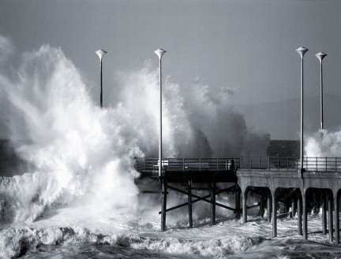
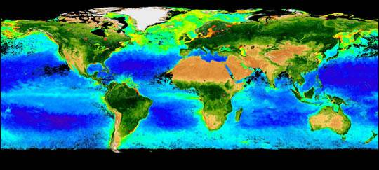
Environmental Observations – at the heart of CEH’s new Research Strategy
Addresses 3 major societal & environmental challenges
Securing the value of nature
Building resilience to
environmental hazards
Managing environmental
change

Slide 3
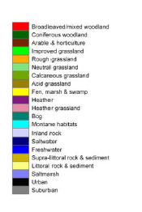
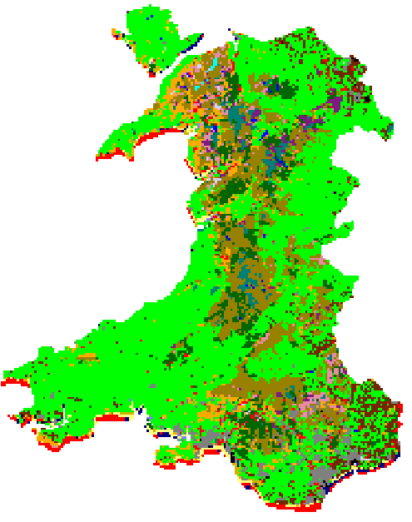
Wales context
Agri-environment schemes deliver Axis 2 of the Rural Development Plan across Europe
All countries have to report on impacts and outcomes but do so at a highly variable level
Wales has developed the largest monitoring programme of any country in the EU (£9m over 4 years)

Slide 4

Wales agri-environment scheme
An ambitious whole farm sustainable land management scheme with 5 priorities:
        Combating climate change
        Improving water management
        Maintaining and enhancing biodiversity
        Landscape and historic landscape
        Increasing area and improving management of woodland
      Peatland is involved in 4 of these issues + ministerial announcement announced commitment to restore all peatlands over next 7 years

Slide 5
Glastir Monitoring and Evaluation Programme Approach
360 x 1km squares sampled over a 4 year rolling cycle
Within each squares, a wide range of measurements covering biophysical, social and economic metrics
For some hard to measure outcomes, new methods are being developed e.g, mobile GHG flux towers with COSMOS sensors, modelling, remote sensing...
Remote sensing being used to:
  Upscale using Landcover map 2007
  Identify woody features
  Develop new approaches to High Nature Value Farmland
  Identify peatland extent and condition

Slide 6
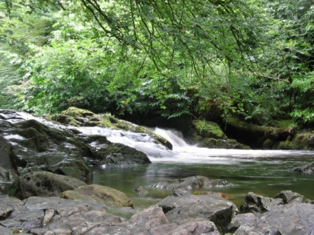
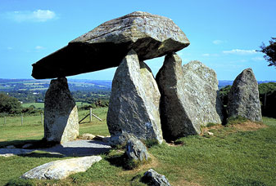
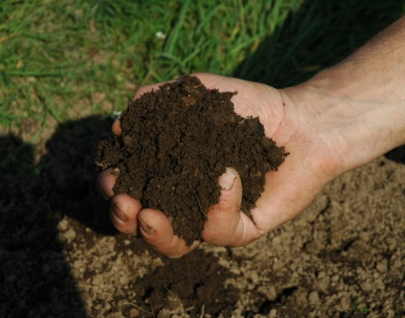

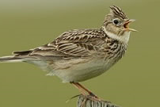
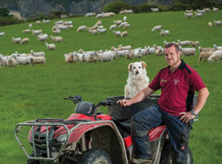
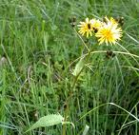

Co-located measurements in 1km² to identify co-benefits and trade-offs of natural capital and ecosystem services:
Habitats and linear features
Species (birds, invertebrates and plants)
Streams and ponds (habitat, macro-invertebrates, diatoms, aquatic, plants, chemistry)
Soil (physical structure, erosion, pesticides, nutrients and biodiversity)
Diffuse Pollution and Climate Change Mitigation
Landscape including historic environment features, access and recreation
Economics for farmers & social surveys to identify wider benefits within Wales
X

Slide 7
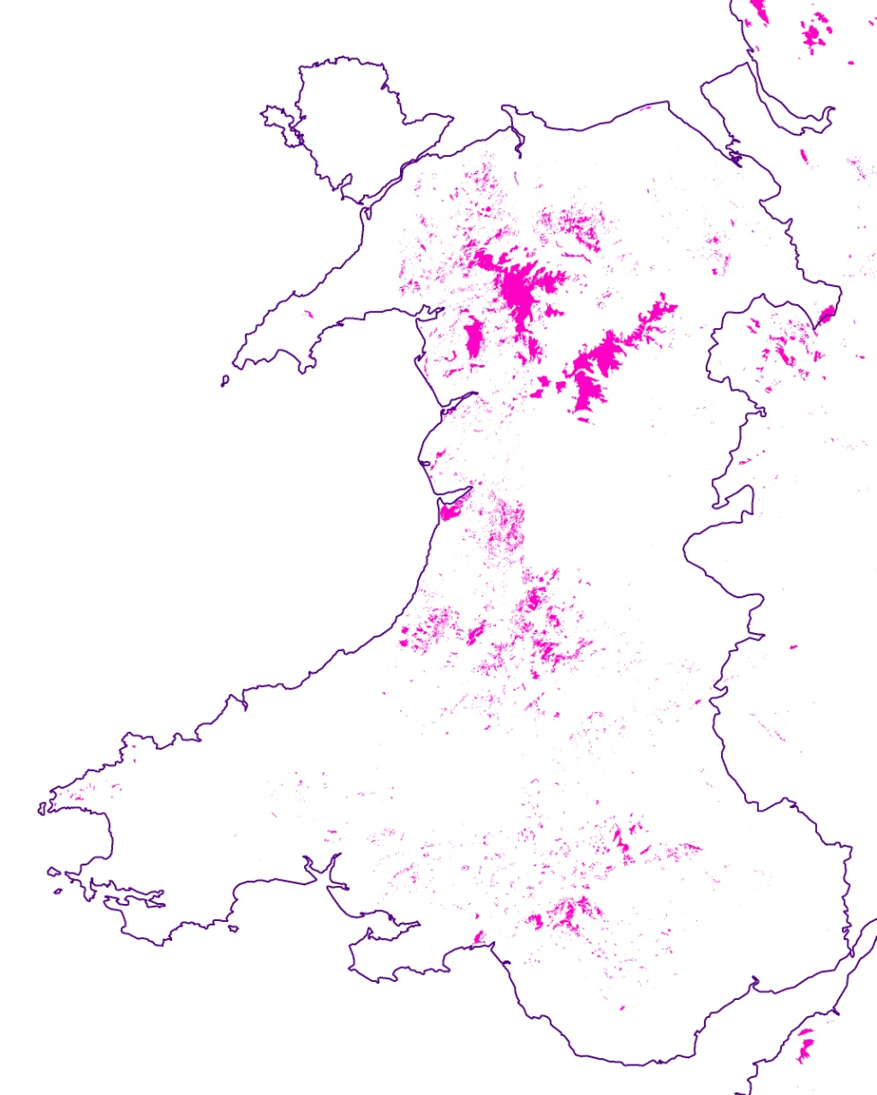

Peat questions
To effectively prioritise and monitor peat restoration we need to agree:
Where the peat is
Where it is in need of restoration:
  Drained
  Eroded
  Planted with trees
Where it is aggrading or degrading and identify links to Glastir
Peat in Wales
Cranfield (250k) and BGS (50k) data for peat polygons

Slide 8
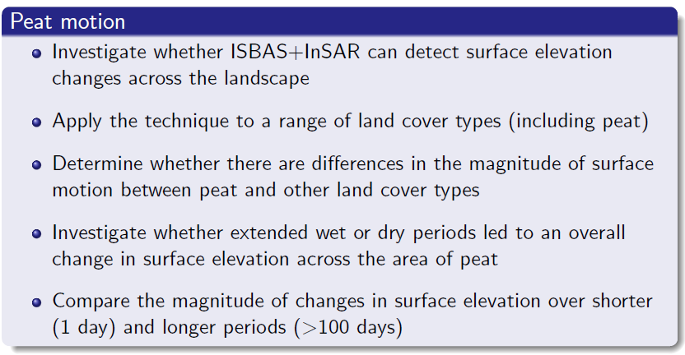
Peat motion

Slide 9
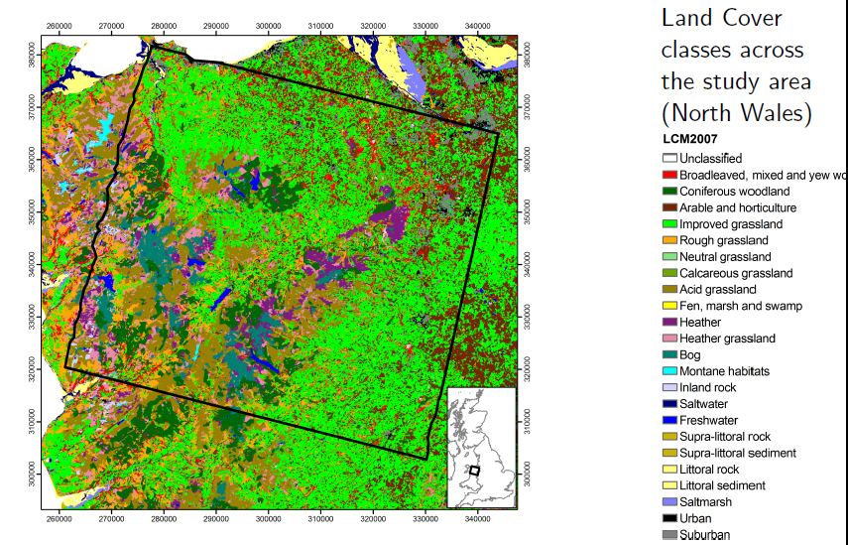
Study site in N Wales

Slide 10
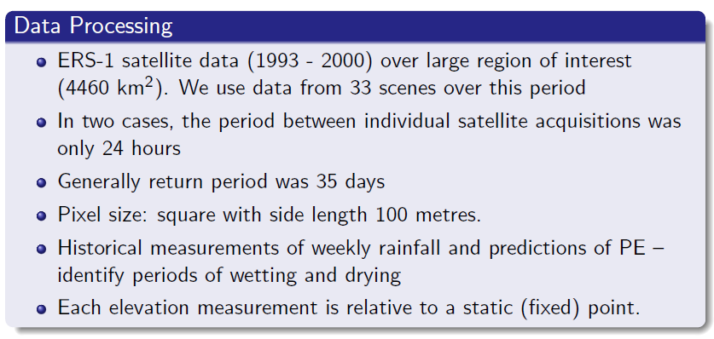
Method

Slide 11
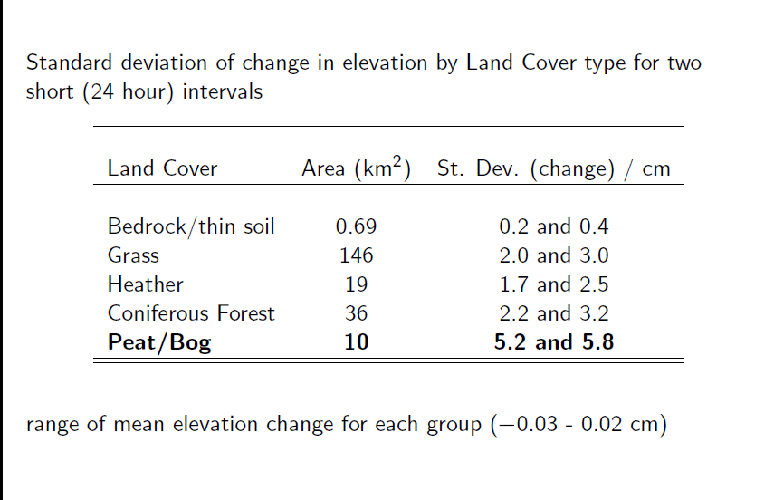
Peat motion results

Slide 12
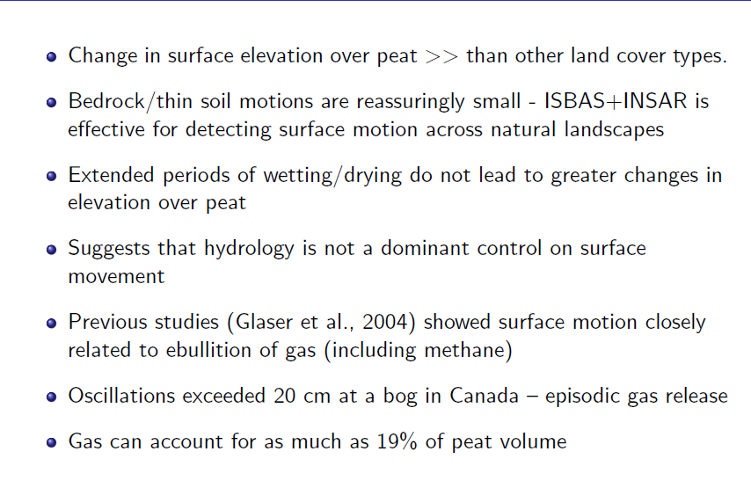
Preliminary conclusions on peatland work

Slide 13
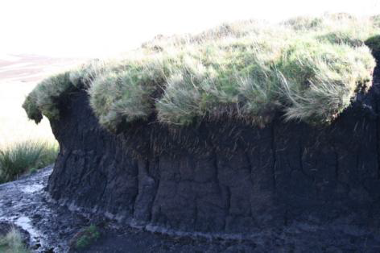
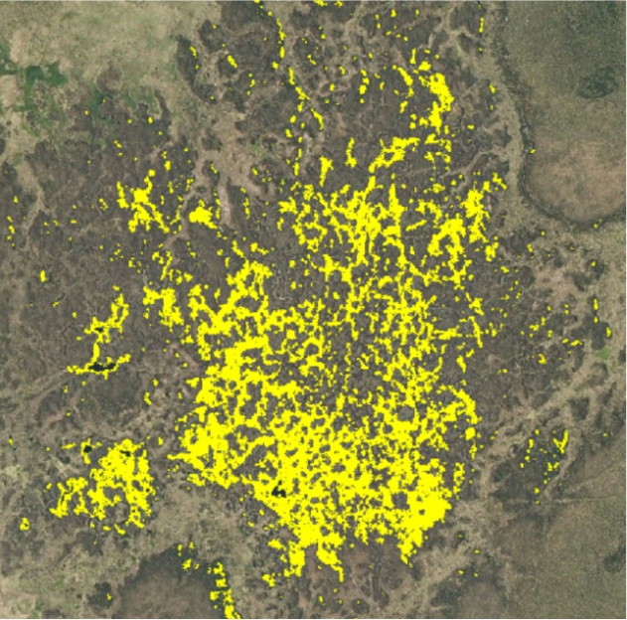
Next steps
Can we use peat motion to help agree where deep peat is?
By analysing over time – can we determine rate of peat growth or loss?
Can we remotely identify drained peat and link to other management practices and vegetation types to inform Glastir prescriptions.

Slide 14












Questions? bae@ceh.ac.uk
The GMEP team

Slide 15
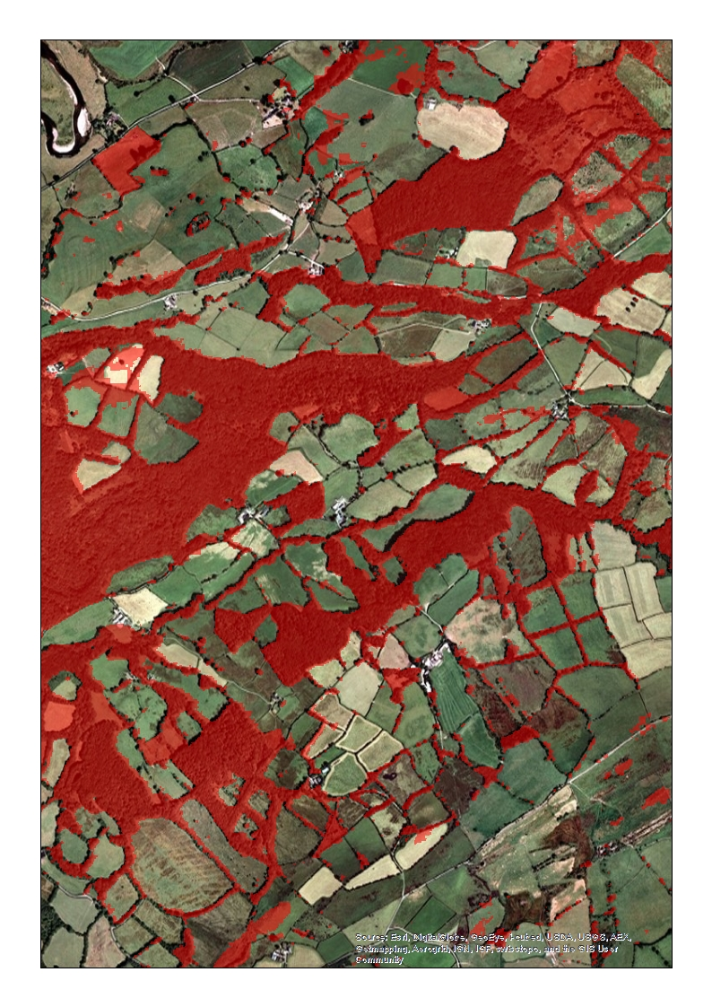
Woodland extent and condition
Is Glastir leading to increased riparian and linear features?
CEH is developing a woody features dataset using
LCM, NDVI and NEXTMAP canopy height data
that will identify areas, linears and points for woodland
Contact: Lindsay Maskell (CEH)

Slide 16
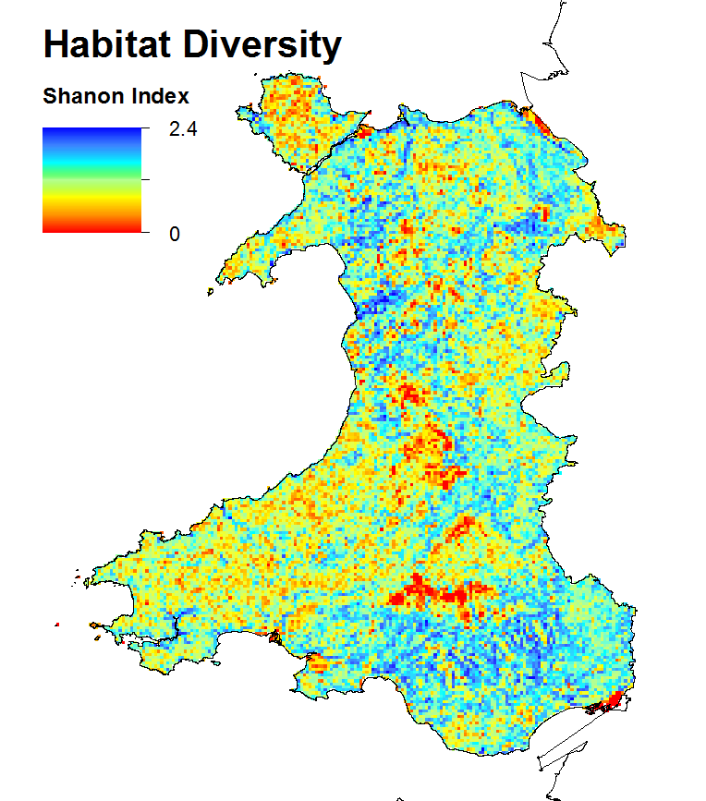
High Nature Value Farmland
The RDP requires metrics to indicate impact on HNV
Little consensus on what it is
CEH exploring ways of combining an array of information to identify areas in Wales for Types I, II and III e.g
Semi-natural habitat areas
Habitat diversity
Species presence

